Slide 1
PROJECT REVIEW
Learning Management System
P.PRABHUDAYA
V.PRASAD
P.SAI RAM

Slide 2
Abstract:
The Learning Management System (LMS) is an online platform designed to facilitate the management of educational content and student engagement. This project aims to create a simple yet effective LMS using technologies such as HTML, CSS, Bootstrap, JavaScript, Django, and SQLite. The system allows instructors to upload and manage courses, while students can view, enroll, and track their progress. The LMS will also feature user authentication, interactive content delivery, and discussion forums. This mini-project is an initial step toward creating a robust and scalable platform for e-learning, providing the essential tools for an engaging and efficient learning experience.

Slide 3
Problem Statement:
The traditional education system has limitations in terms of accessibility, flexibility, and scalability. With the rise of digital learning, the need for an efficient, interactive, and easily accessible platform has become essential. Existing Learning Management Systems are often complex, difficult to navigate, or overly expensive for smaller educational institutions or independent instructors. This project seeks to develop a simple LMS that addresses the following problems:
Lack of a centralized platform for managing courses, content, and students.
Limited interaction between students and instructors.
Difficulties in tracking student progress and performance.
Accessibility issues for students in remote locations or those with time constraints.
The aim is to create a user-friendly, accessible LMS for educational institutions to help improve the learning experience for both students and instructors

Slide 4
Project Objectives:
The main objectives of this project are:
Course Management: Allow instructors to upload, update, and manage courses.
Student Management: Enable students to view and enroll in courses.
User Authentication: Implement login functionality for both instructors and students.
Content Delivery: Provide a system to upload and view educational materials (e.g., PDFs, videos).
Progress Tracking: Track student progress on enrolled courses.
Interactive Features: Allow students to post queries, interact with course content, and submit assignments.
Chatbat: To create a chatbot. It is helpful for the users and get more knowledge about our project
Course Creation: A teacher can create a course dynamically and perform such operations as creating a syllabus, adding content, tracking students etc.

Slide 5
Existing System:
Current Learning Management Systems available in the market include platforms like Moodle, Blackboard, and Canvas. These systems provide comprehensive tools for course management, assessment tracking, and communication. However, they come with some limitations:
Complexity: These platforms can be overwhelming for new users due to their complex interfaces and steep learning curves.
Cost: Many of these systems require expensive licenses or subscriptions, making them inaccessible to smaller institutions or individual educators.
Limited Customization: Most existing LMS platforms offer limited options for customization, which may not fully meet the specific needs of certain institutions or courses.
Dependency on Internet Connectivity: Some platforms have issues with performance and availability in low-bandwidth areas.
Our system aims to address these issues by creating a lightweight, customizable LMS that is easy to use, affordable, and flexible for a variety of learning environments.

Slide 6
Advantages:
The Learning Management System developed in this mini project offers several key advantages:
User-Friendly Interface: The system is designed to be intuitive and easy to navigate for both instructors and students, requiring minimal training.
Cost-Effective: Being a simple web-based solution, it eliminates the need for expensive infrastructure or third-party licenses, making it affordable for small institutions or independent educators.
Scalability: While this project is designed to be simple, it can be easily extended to support additional features such as grading, advanced reporting, and integration with third-party tools.
Interactive Learning: Features like course materials, assignments, quizzes, and discussion forums enhance student engagement and interaction.
Centralized Management: Instructors and administrators can manage courses, student progress, and content from a single platform, improving efficiency.

Slide 7

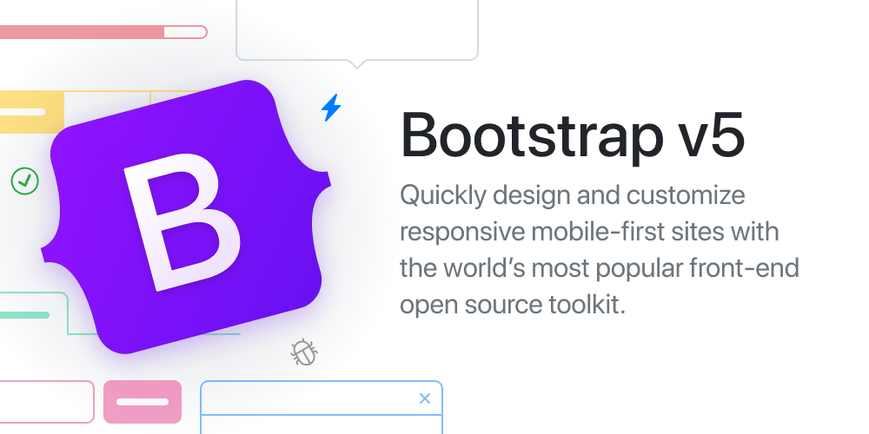




Technologies Used
This Photo by Unknown Author is licensed under CC BY-SA-NC

Slide 8
System Requirements:
Hardware Requirements:
Processor: 1.5 GHz or higher (Intel Core i3 or equivalent)
RAM: 2 GB or more
Storage: 10 GB free disk space (for software installation and database storage)
Internet Connection: Stable internet connection for access to the LMS platform (for online learning environments)
Software Requirements:
Operating System: Windows
Web Browser: Google Chrome, Mozilla Firefox, or Safari (latest versions)
Database Management System (DBMS): MySQL
Languages:
HTML: For structuring the pages
CSS: For styling and responsive design
JavaScript: For client-side interactions and validations
Django: high-level, open-source Python web framework
SQLite: For database management and queries

Slide 9
LMS System Modules
1. User Management Module
6. Quiz & Assessment Module
2. Course Management Module
7. Payment & Subscription Module
3. Syllabus & Curriculum Management Module
8. Security & Compliance Module
4. Chatbot & Communication Module
9. Accessibility & Mobile Optimization
5. Student Progress & Performance Tracking Module
10. Admin Dashboard & Reports Module

Slide 10
UML DIAGRAMS

Slide 11
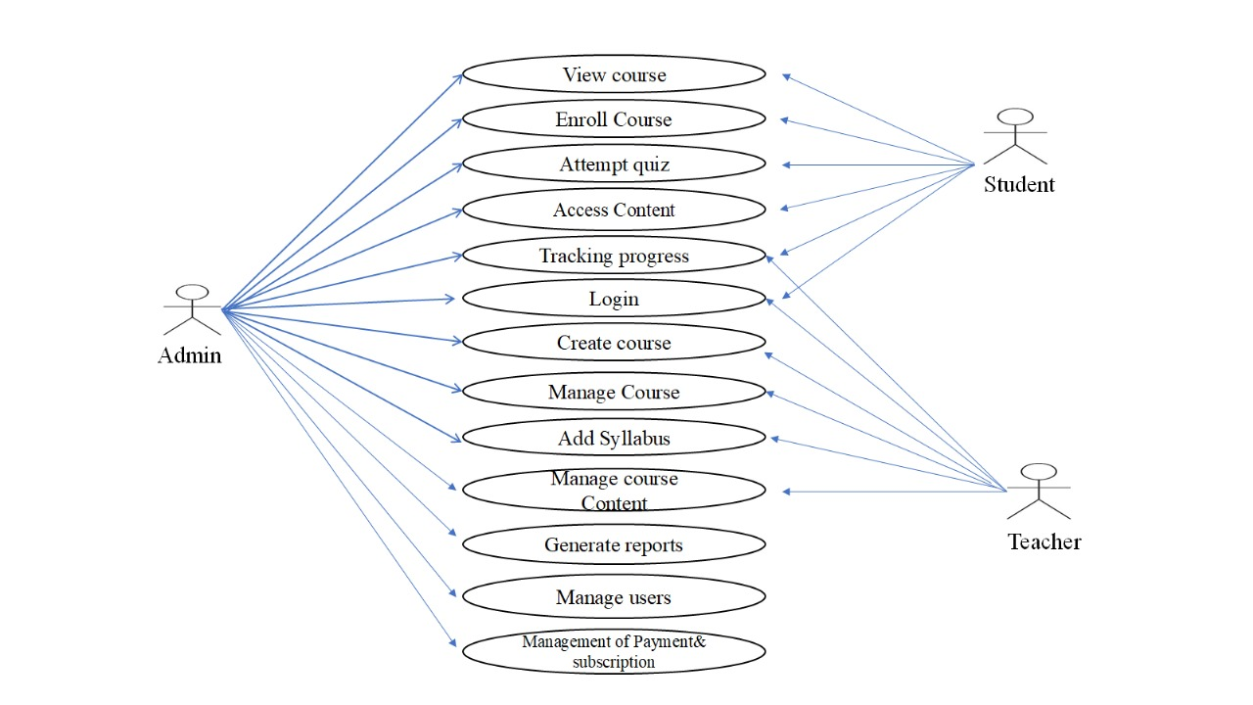
USE CASE DIAGRAM

Slide 12
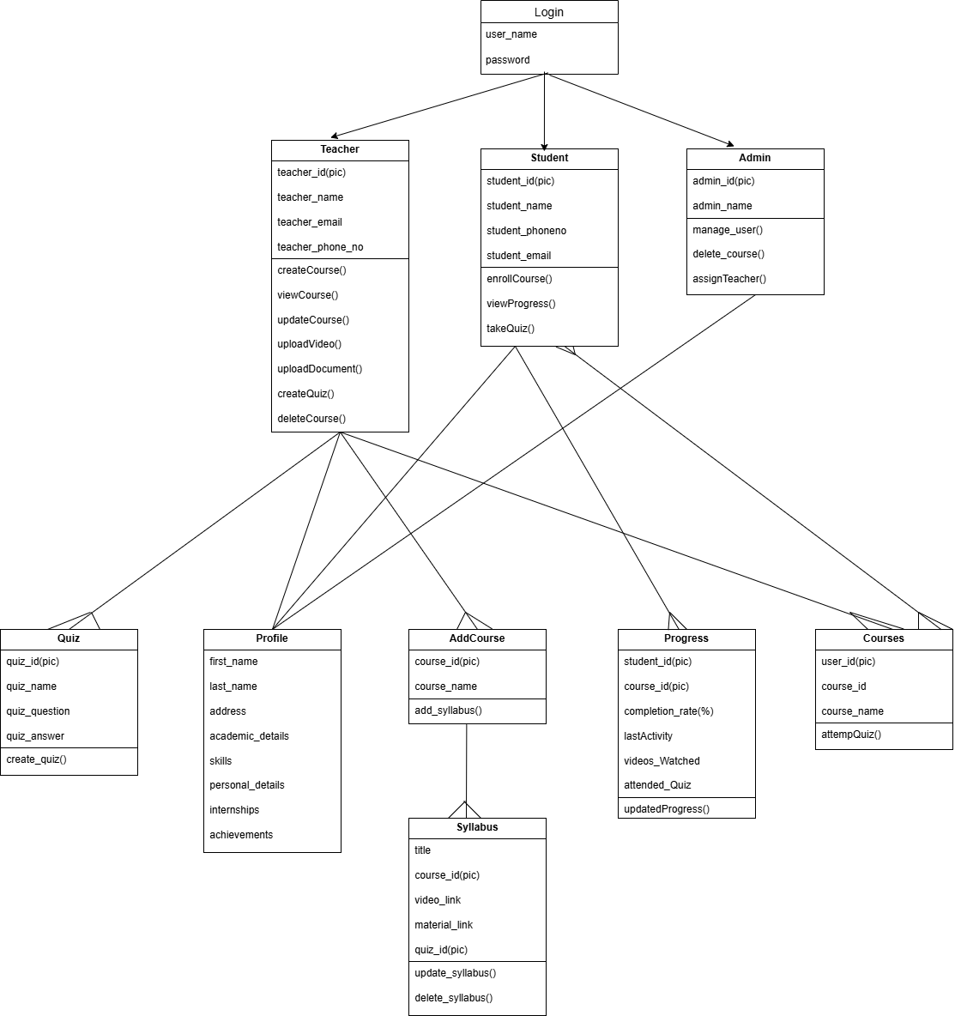
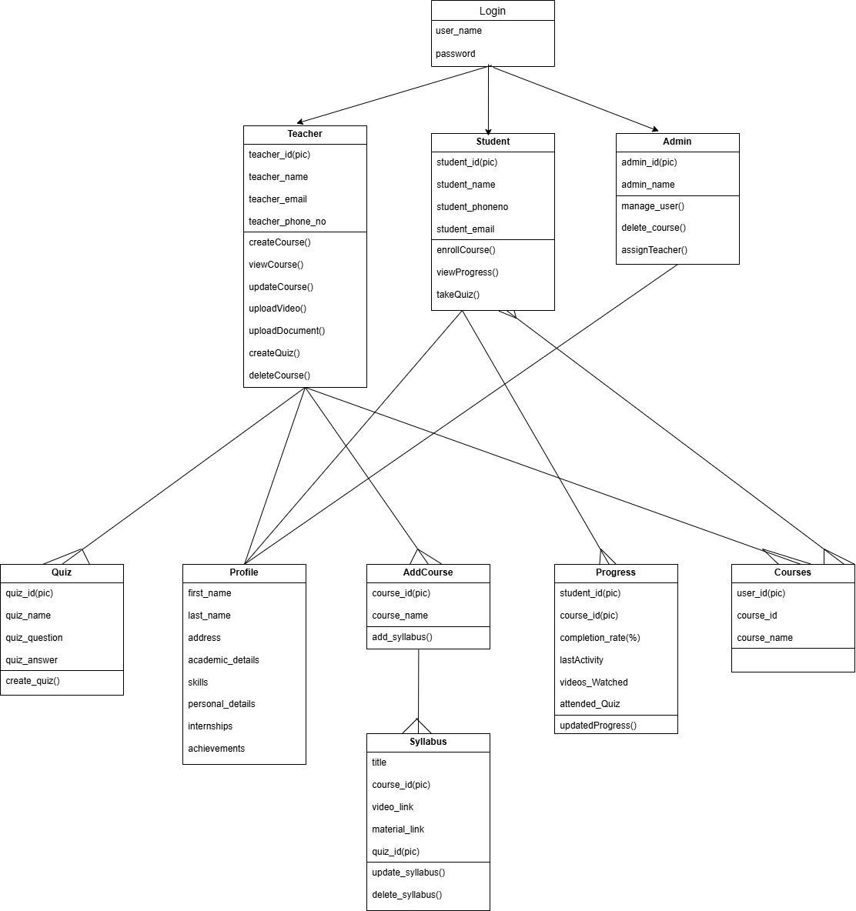
CLASS DIAGRAM
CLASS DIAGRAM

Slide 13
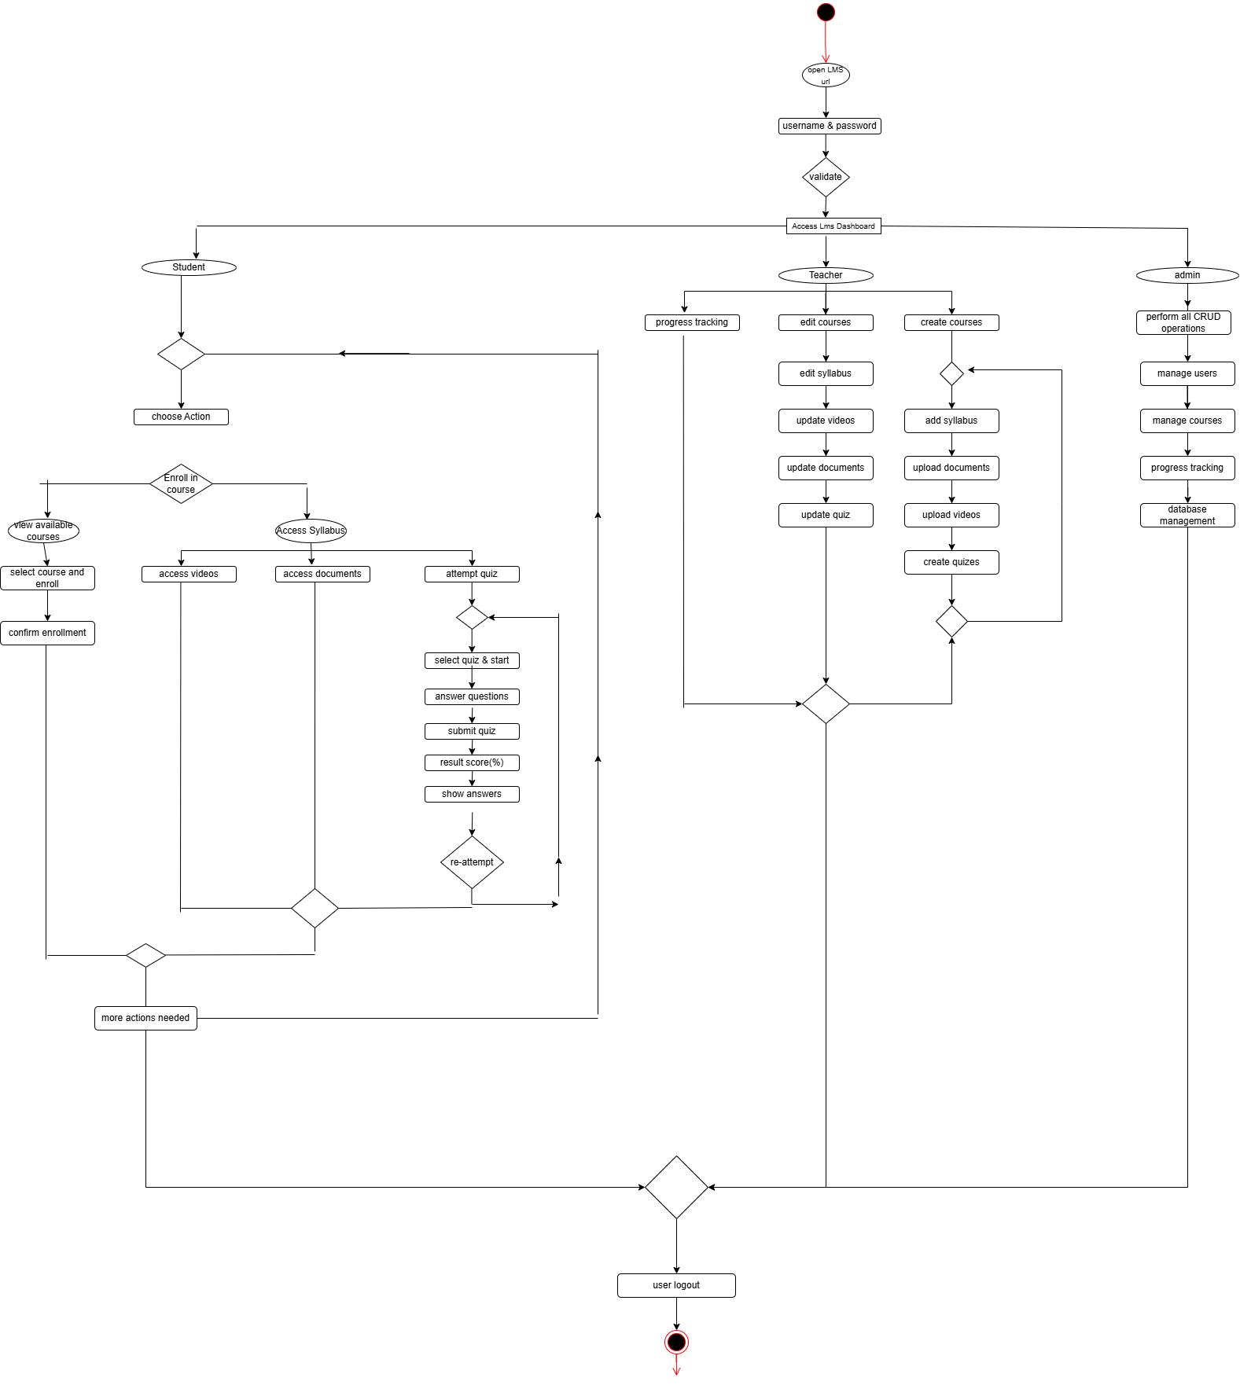
ACTIVITY DIAGRAM

Slide 14
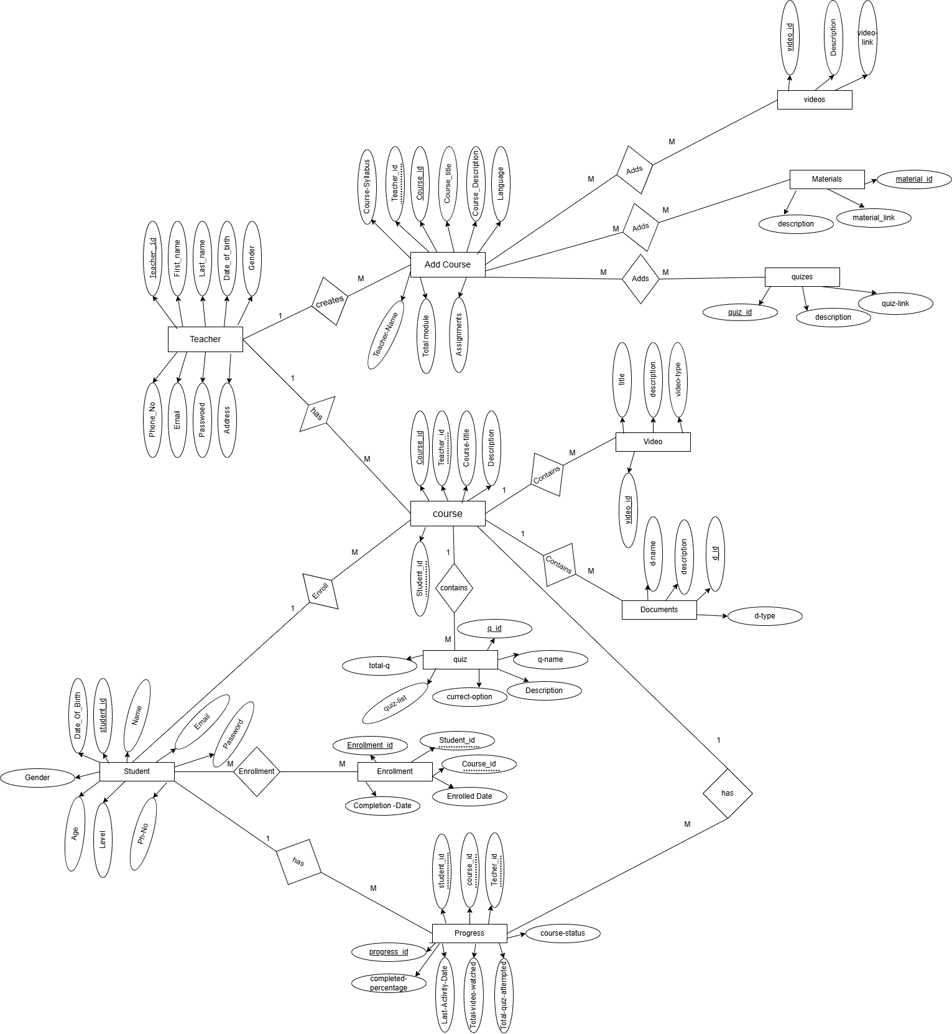
ER DIAGRAM

Slide 15
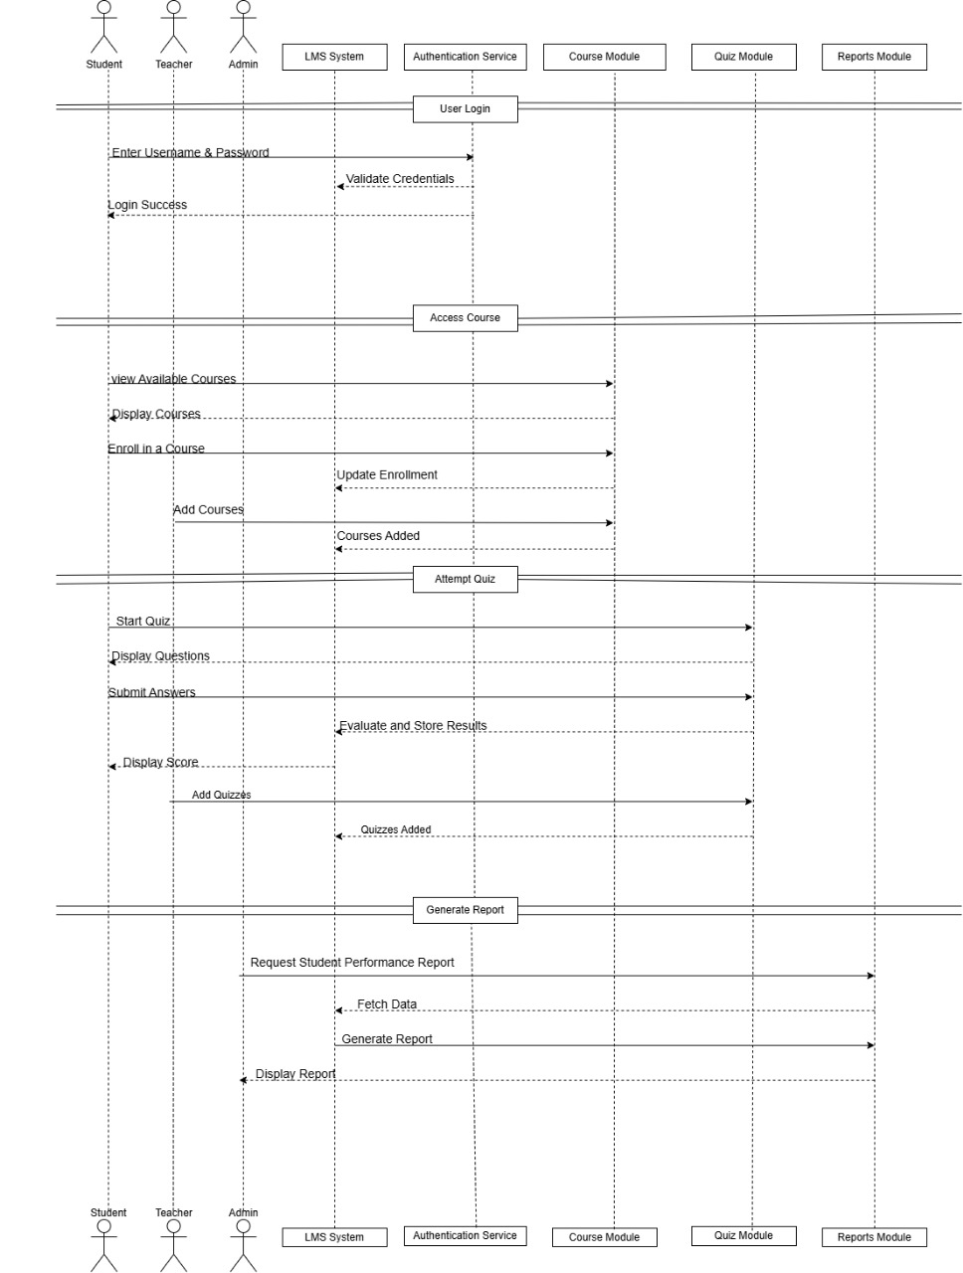
SEQUENCE DIAGRAM

Slide 16
Database Tables
User Table
Columns | Type | Constraints
User-id | NUMBER | PRIMARY KEY
User-Name | VARCHAR2(20) | NOT NULL
Email | VARCHAR2(20) | NOT NULL
Password | VARCHAR2(20) | NOT NULL
Gender | VARCHAR2(20) | NOT NULL
Course Table
Columns | Type | Constraints
Course-Id | CHAR(7) | FOREIGN KEY
Course-No | VARCHAR(20) | NOT NULL
Description | VARCHAR(20) | NOT NULL
Total-syllabus | VARCHAR(20) | NOT NULL

Slide 17
Student Table
Columns | Type | Constraints
User-id | CHAR(10) | FOREIGN KEY
User-Name | VARCHAR2(20) | NOT NULL
Password | VARCHAR2(20) | NOT NULL
Role | CHAR(10) | NOT NULL
Gender | VARCHAR2(20) | NOT NULL
Phone Number | CHAR(10) | NOT NULL
Email | VARCHAR2(20) | NOT NULL

Slide 18
Teacher Table
Columns | Type | Constraints
User-id | CHAR(10) | FOREIGN KEY
User-Name | VARCHAR(20) | NOT NULL
Phone Number | CHAR(10) | NN,CHECK(LENGTH(P)<0)
Email | VARCHAR(20) | NOT NULL
Gender | VARCHAR(20) | NOT NULL
Videos Table
Columns | Type | Constraints
Video-id | CHAR(10) | PRIMARY KEY
Video-Name | VARCHAR(20) | NOT NULL
Description | VARCHAR(20) | NOT NULL
Link | VARCHAR(20) | NOT NULL,UNIQUE

Slide 19
Documents Table
Columns | Type | Constraints
D-Id | CHAR(8) | PRIMARY KEY
D-Name | VARCHAR(20) | NOT NULL,DEFAULT
Description | VARCHAR(20) | NOT NULL,DEFAULT
Link | VARCHAR(20) | NOT NULL,DEFAULT
Quiz Title
Columns | Type | Constraints
Quiz-Id | CHAR(8) | FOREIGN KEY
Quiz-Name | VARCHAR(20) | NOT NULL ,DEFAULT
Date | DATE | NOT NULL

Slide 20
Quiz Creation
Columns | Type | Constraints
Quiz-Id | CHAR(10) | (PK),NOT NULL
Quiz-Name | VARCHAR(20) | NOT NULL,DEFAULT
Quiz-Description | VARCHAR(20) | NOT NULL,DEFAULT
Questions Table
Columns | Type | Constraints
Question-Id | CHAR(7) | FOREIGN KEY
Question-Description | VARCHAR(20) | NOT NULL
Question-Type | VARCHAR(20) | NOT NULL
Marks | NUMBER | NOT NULL

Slide 21
Answers Table
Columns | Type | Constraints
Quiz-Id | CHAR(7) | FOREIGN KEY
Option-A | CHAR(7) | PRIMARY KEY
Option-B | VARCHAR(20) | NOT NULL
Option-C | VARCHAR(20) | NOT NULL
Option-D | VARCHAR(20) | NOT NULL
Correct-Option | VARCHAR(20) | NOT NULL
Question-Id | CHAR(7) | FOREIGN KEY

Slide 22
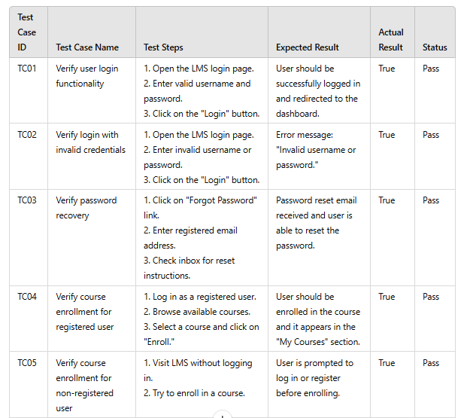
Test Cases for the Learning Management System :

Slide 23
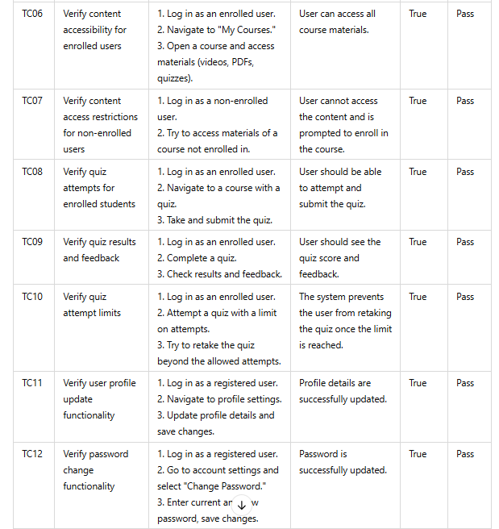

Slide 24
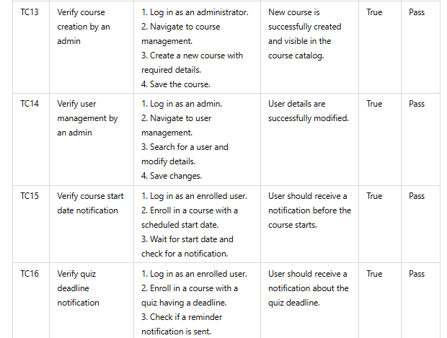

Slide 25
User Management Module
P. Jaya Venkata Sai Ram

Slide 26
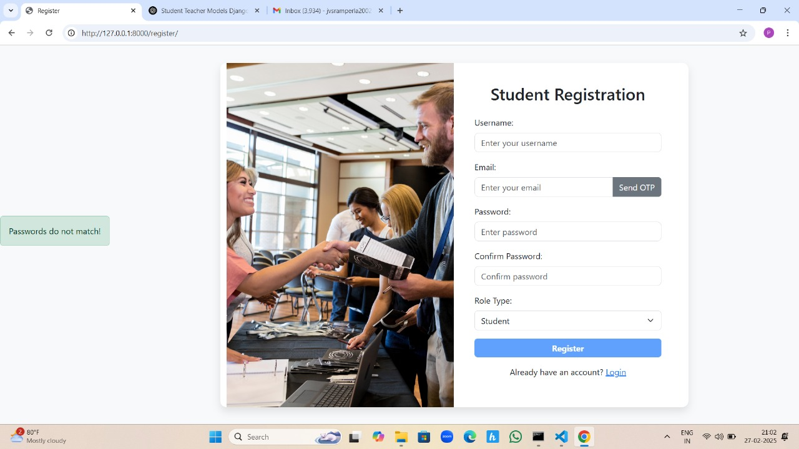

Slide 27
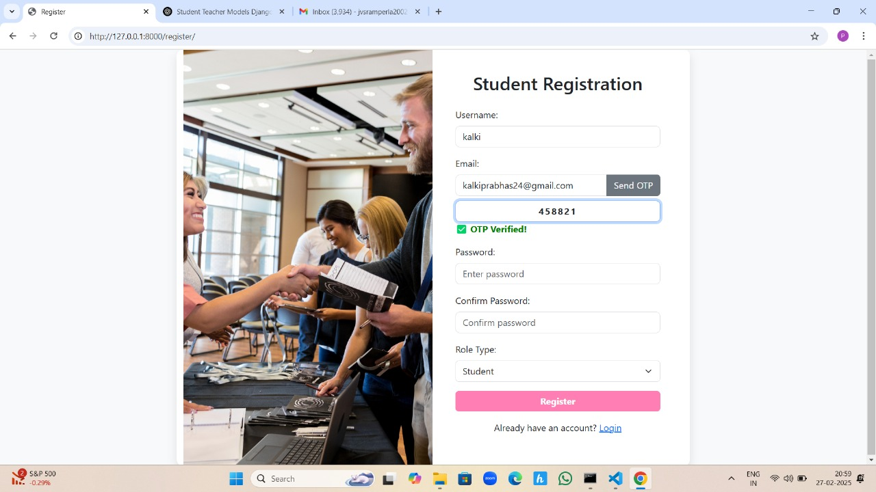

Slide 28
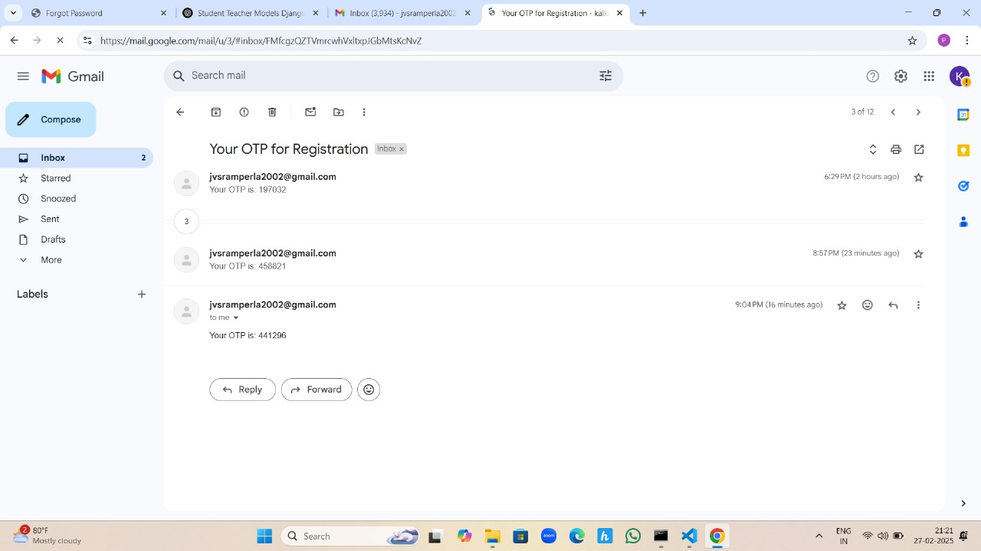

Slide 29
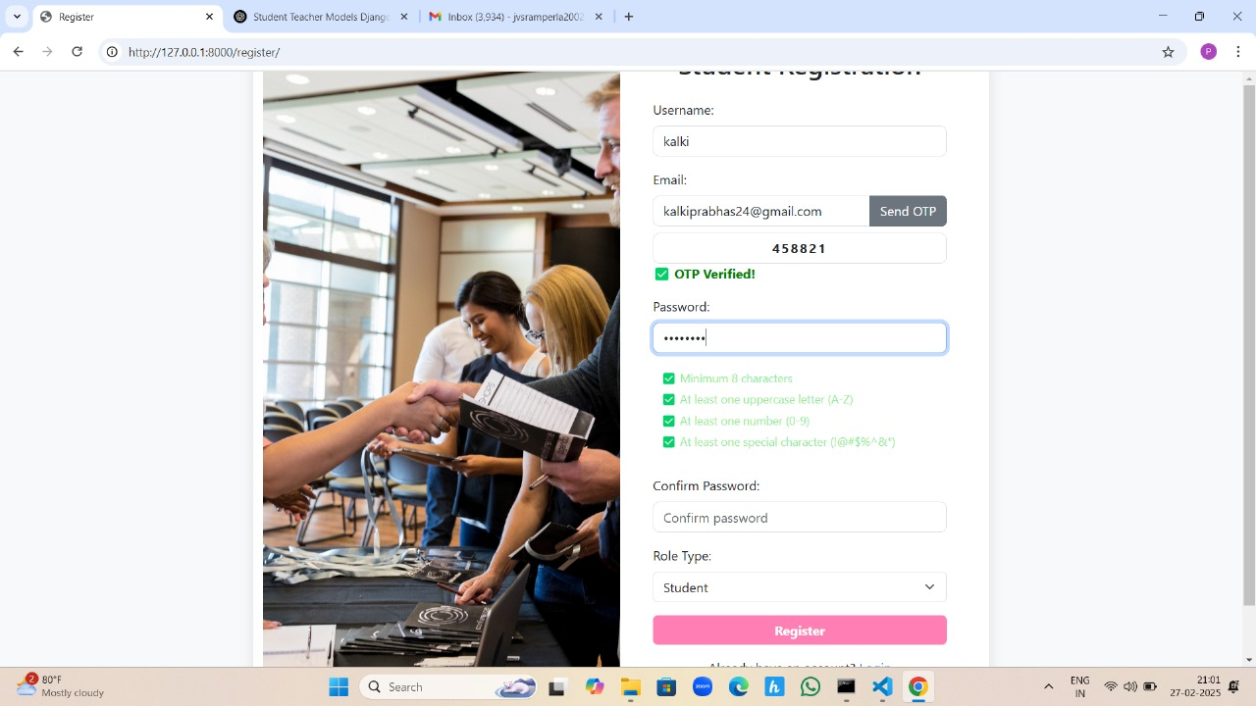

Slide 30
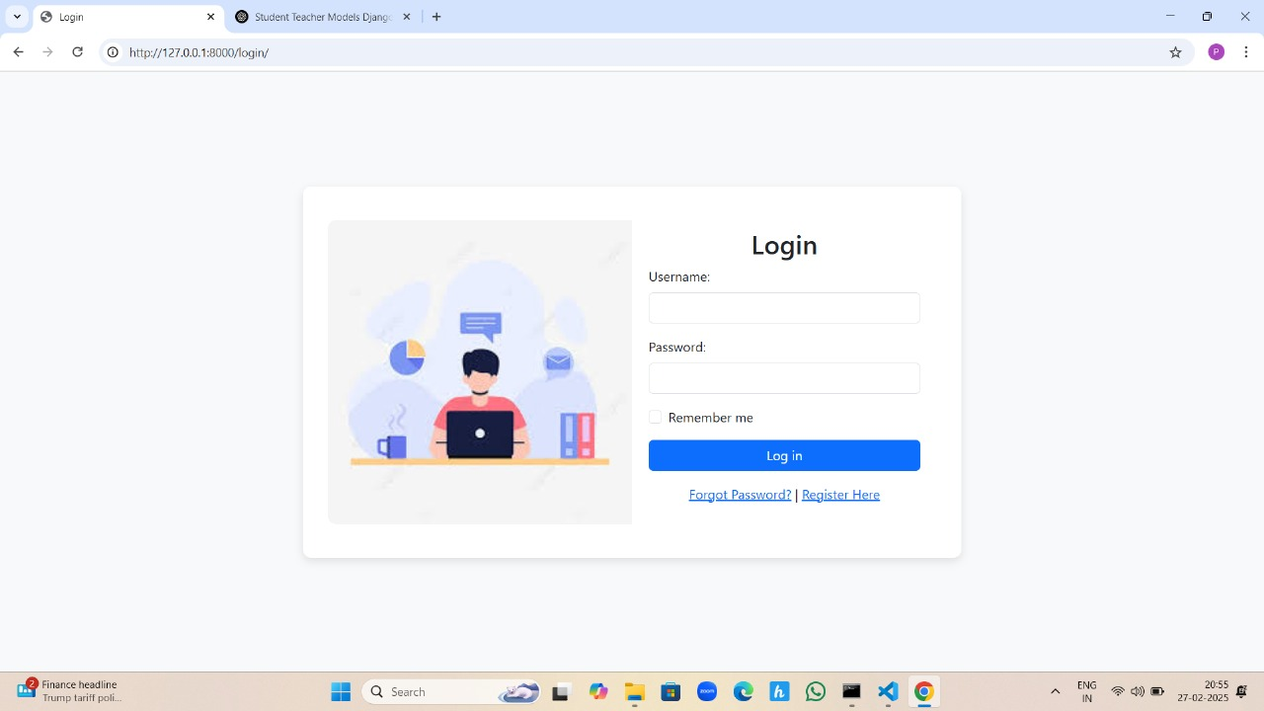

Slide 31
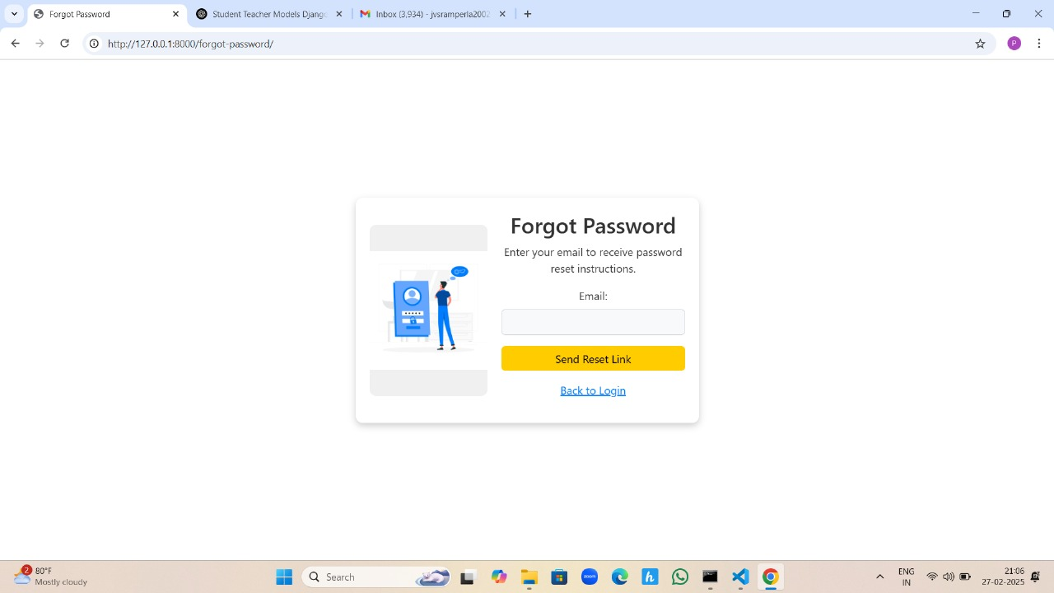

Slide 32
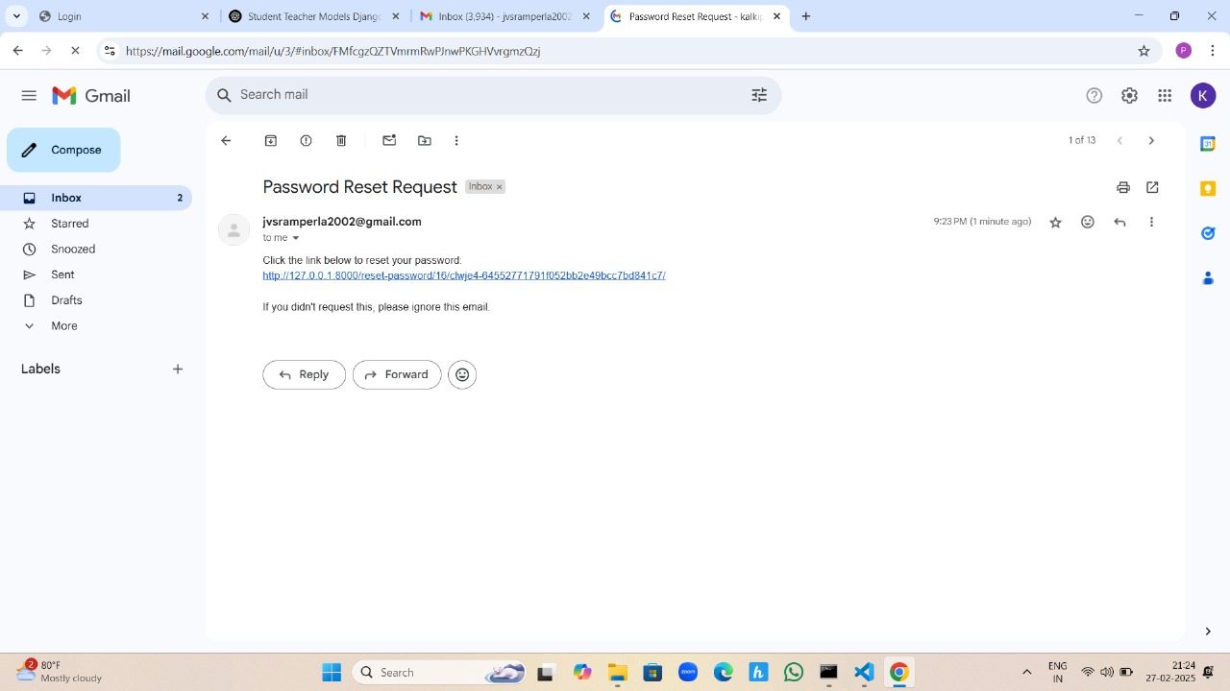

Slide 33
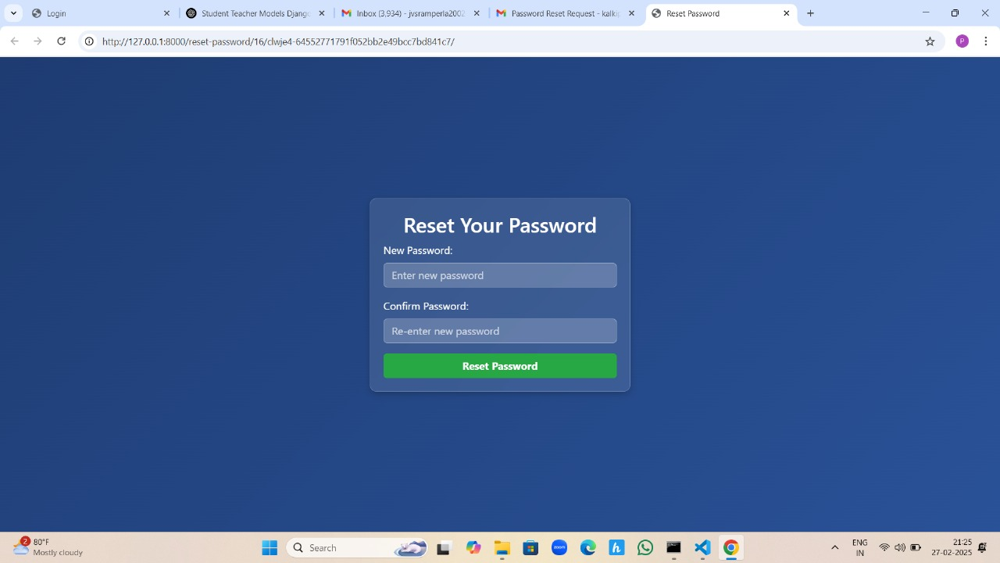

Slide 34
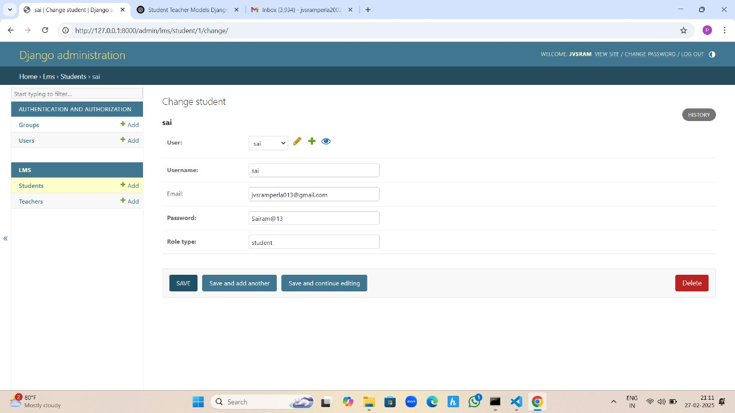

Slide 35
Chatbot & Communication Module
D. Prasad
Why Use a Chatbot?
Provides instant responses to users
Available 24/7 – No waiting time
Reduces human workload in customer service
Can handle multiple users simultaneously
Enhances user engagement and experience

Slide 36
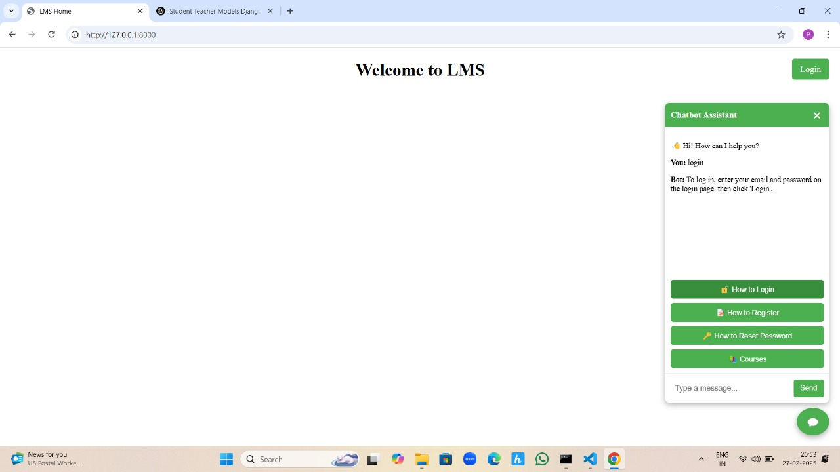

Slide 37


Slide 38
Predefined Q&A for Chatbot
Here are some sample predefined questions and answers for your chatbot:
Question: What is your name? Answer: Hi! I am your virtual assistant, ready to help you.
Question: How can I reset my password? Answer: You can reset your password by clicking on "Forgot Password" on the login page.
Question: What are your working hours? Answer: We are available 24/7 to assist you.

Slide 39
Course Management Module
P.Prabhudaya
Our Course Management System provides a dynamic platform for teachers to create, manage, and organize courses efficiently. The system allows instructors to create new courses dynamically, adding essential details such as title, description, category, and number of lectures. The teacher dashboard displays all created courses, providing an overview of available subjects. Clicking on a course redirects to the syllabus page, where instructors can add and manage topics, subtopics, videos, documents, and quizzes in a structured format. This system enhances the learning experience by enabling a well-organized and interactive course management process.

Slide 40
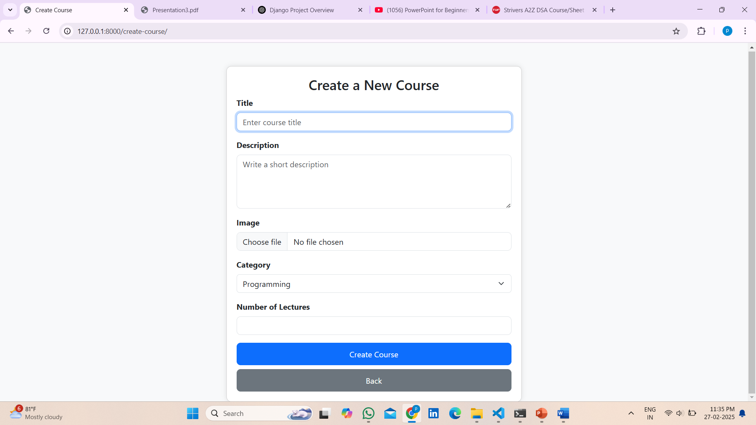
Create a dynamic course

Slide 41
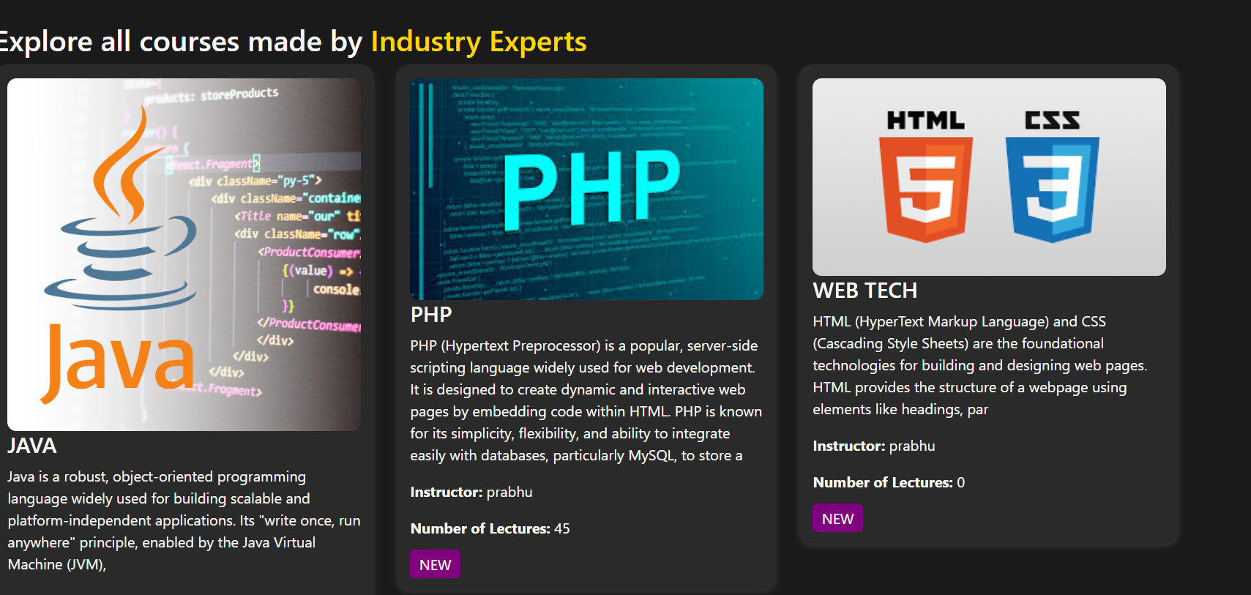
All Courses List

Slide 42
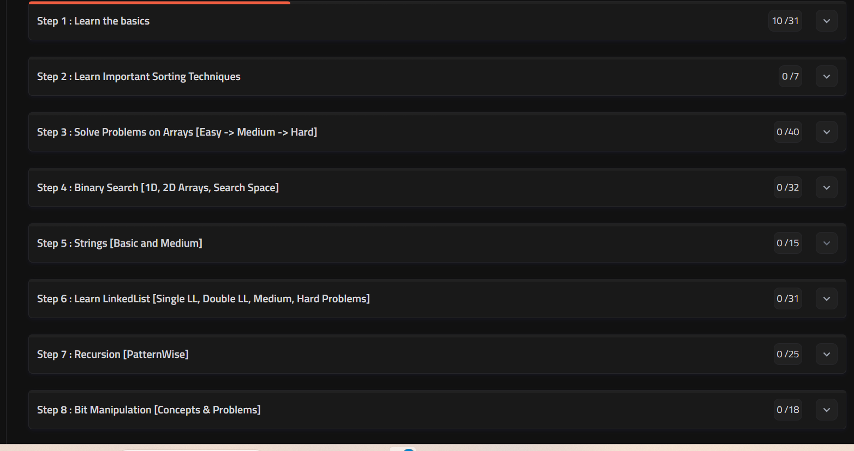
Syllabus page

Slide 43
Conclusion
The Learning Management System (LMS) developed in this project showcases a seamless integration of modern web technologies to create an intuitive and efficient platform for managing online courses. With dynamic course creation, structured syllabus management, and interactive content support, the system enhances accessibility and ease of use. By addressing key challenges such as usability, engagement, and affordability, this LMS provides an ideal solution for educators and institutions seeking a cost-effective and scalable platform to deliver high-quality online learning experiences.

Slide 44


